Slide 1

Guide TP5 (1/2)
INF8808 | Hiver 2021
Version Python

Slide 2
Objectifs
The goal of this lab is to create an interactive scatter map using open data in JSON and GeoJSON format

Slide 3
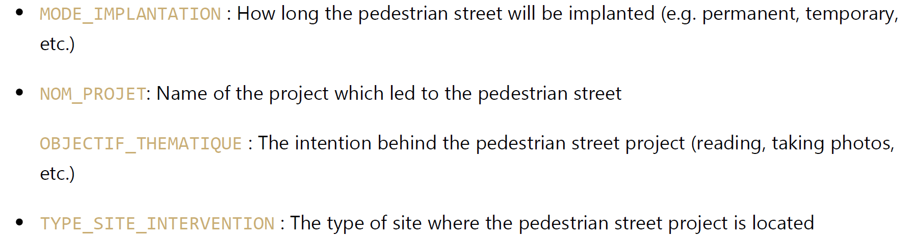
Données
Vous allez utiliser 2 ensembles de données
The first dataset, representing data on pedestrian paths
The dataset contains many properties. The following properties may be useful for this lab :

Slide 4
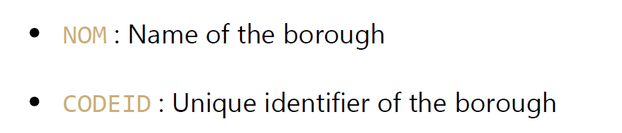
Données
Vous allez utiliser 2 ensembles de données
The second dataset, representing data on contains all the geometries necessary to display the boroughs on a map.
The dataset contains many properties. The following properties may be useful for this lab:

Slide 5
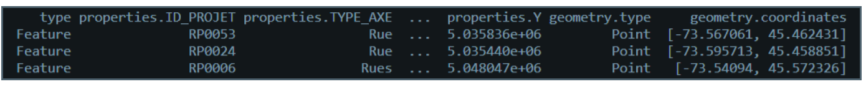
Data preprocessing
Preprocess the data we provide you about the pedestrian streets and about Montreal's geography
The data contained in the GeoJSON and JSON files is raw, so it is necessary to process certain parts of it so they can be properly used by the Plotly library. You will have to complete these steps:
Convert the data to a pandas dataframe - ‘fonction to_df’
Simplify the names which will later be displayed in the legend - fonction ‘update_titles’
Sort the data for the display - fonction ‘sort_df’
Complete a utility function to get the neighborhood names - fonction ‘get_neighborhoods’

Slide 6
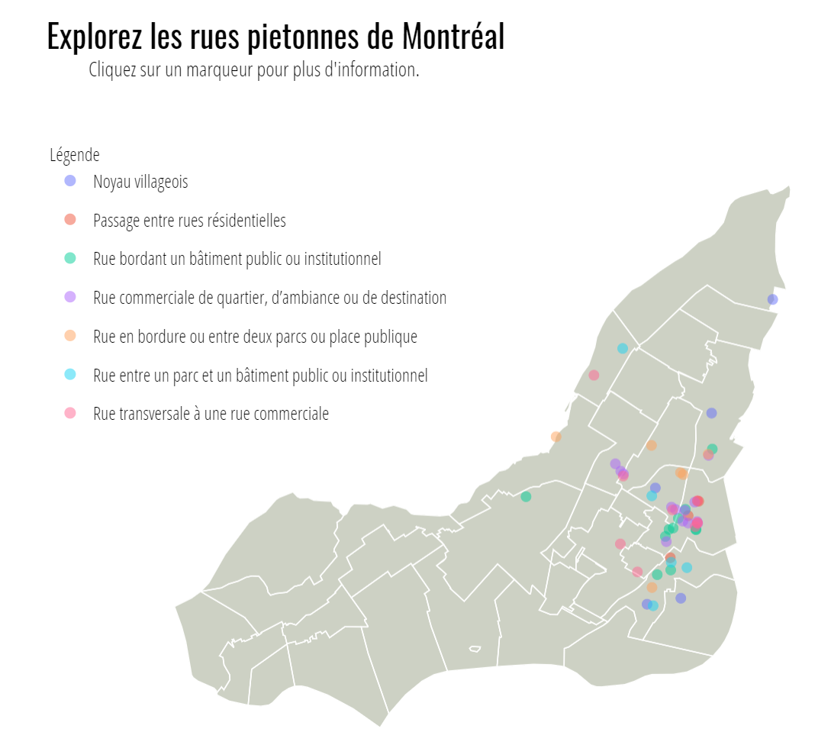
Carte à nuage de points
Implement the main part of the data visualization
You will draw the map base, including the polygons that represent Montreal's neighborhoods:
You may use Plotly's choropleth tracing features,
We provide you with a z_vals parameter in the add_choro_trace, which is a table containing always the same value for z.
We also provided you with the color scale to use, containing only one color
Once the map base is drawn, you will have to add traces representing each type of pedestrian street to the map figure:
Add the trace for the modified one color choropleth map showing the neighborhoods - fonction ‘add_choro_trace’
Add the markers to the map - fonction ‘add_scatter_traces’

Slide 7
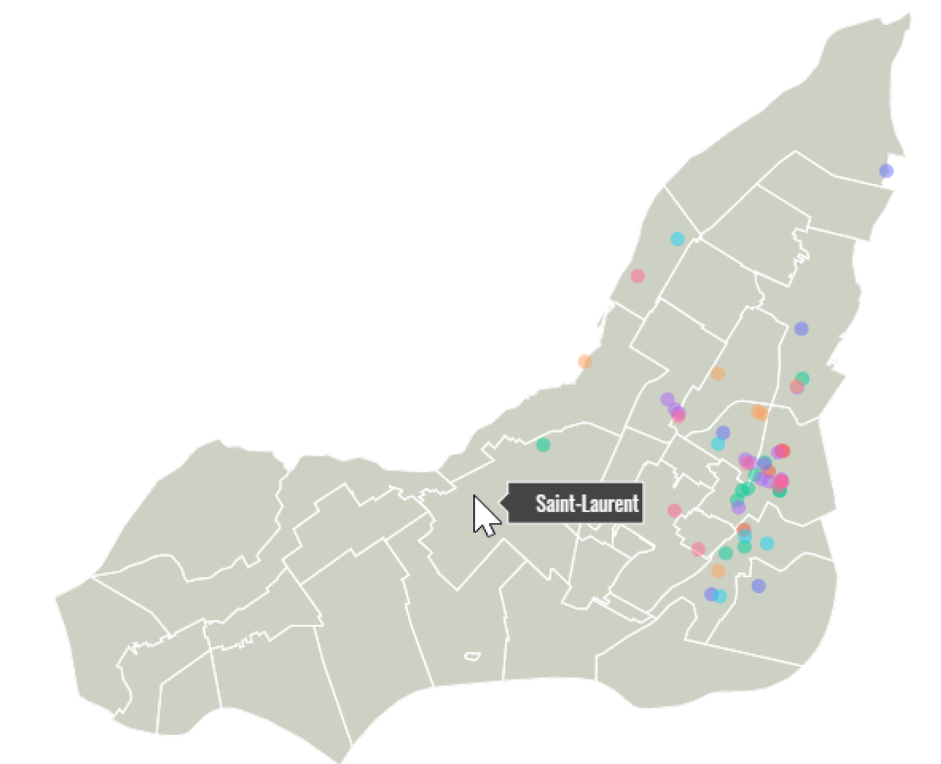
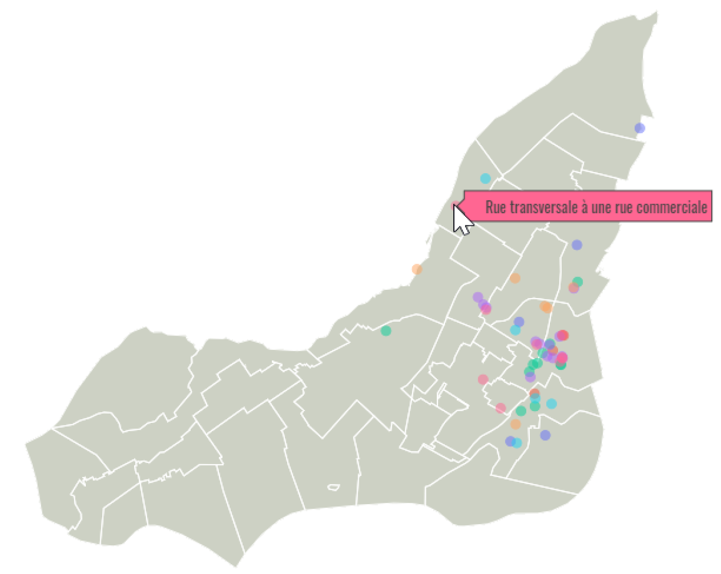
Tooltips
Implémenter le info-bulle
When a neighborhood is displayed, simply its name should be displayed in the tooltip
fonction ‘map_base_hover_template’
When a marker is displayed, simply its type of site should be displayed in the tooltip
Fonction ‘map_marker_hover_template’

Slide 8
Information panel
generate an informational panel which appears to the left of the map when a marker is clicked
You
will have to complete the functions in the file callback.py.
Titre : The panel should contain as title the name of the project, written in the same color as its associated marker
Sous-titre : indicates the intended duration of the site (permanent, temporary, etc.).
When available, the panel should also list the intended themes for the site, presented in the format of an unordered list.
Thus, the steps to follow for this part are:
Handle the default behavior for the map before any click events have been registered - fonction ‘no_clicks’. The panel should not be displayed until a marker is clicked
Handle the behavior for the map when the map base is clicked instead of a marker. If the panel is displayed, its information should stay the same. If the panel is not displayed, it should stay hidden from view - fonction ‘map_marker_clicked’
Handle the behavior when a marker is clicked, so the panel is displayed with the appropriate information - fonction ‘map_marker_clicked’

Slide 9
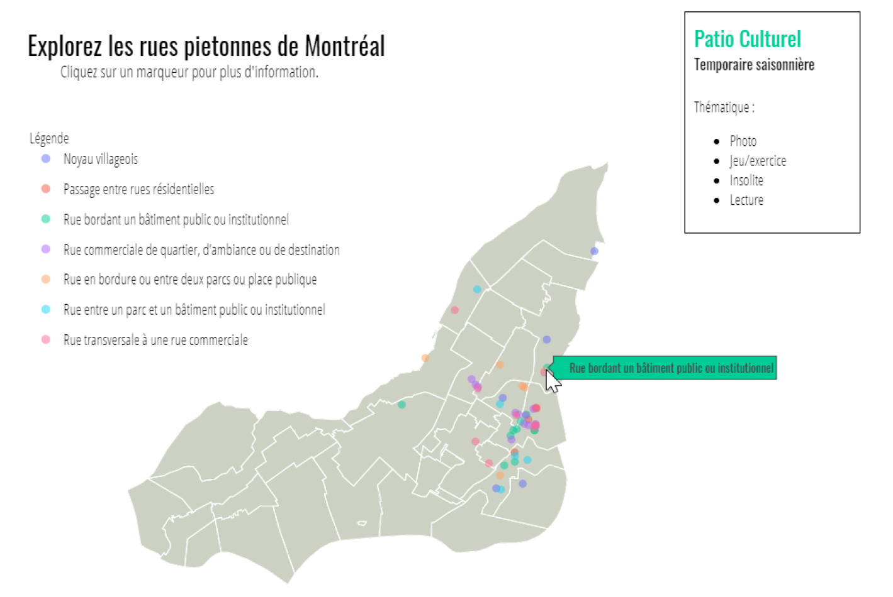
Information panel

Slide 10
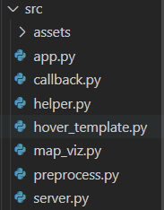
Info générales
File Structure
Create venv and install requirements.txt
You don’t need to modify app.py et server.py
You must fill all the TODO parts on the other files .py

Slide 11
Soumission
Due Date: June 10th 23h59

Slide 12

Question

